Slide 1
3D printing of fused silica glass
MICRO-722
3D Printing with light
Zhi Li
École Polytechnique Fédérale de Lausanne (EPFL)
Laboratory of Foundation Biophotonics (LBP)
November 10, 2025
05. 11. 2025

Slide 2
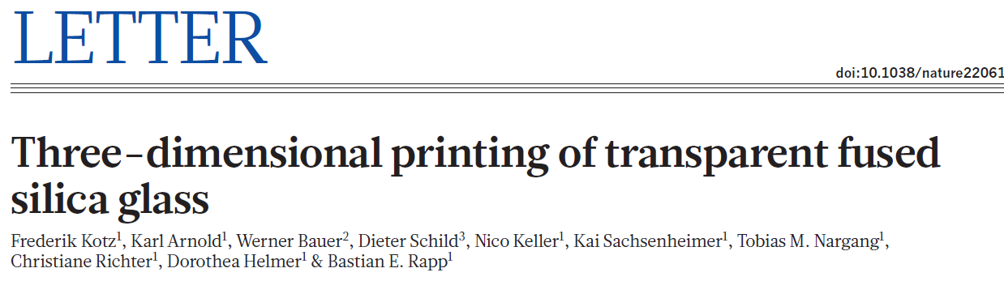
3D printer of fused silica glass
05. 11. 2025

Slide 3
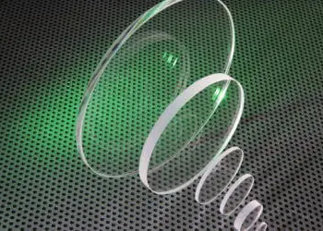
Introduction
Glass is one of the most important high-performance materials used for scientific research, in industry and in society.
unmatched optical transparency, outstanding mechanical, chemical and thermal resistance as well as its thermal and electrical insulating properties.
However, glasses and especially high-purity glasses
such as fused silica glass are difficult to shape, requiring
high-temperature melting and casting processes for macroscopic objects or hazardous chemicals for microscopic features
Using a casting nanocomposite, here they create transparent fused silica glass components using stereolithography 3D printers at resolutions of a few tens of micrometers.
05. 11. 2025
Notes:
the chemical processes needed to remove or pattern fused silica, which is extremely chemically resistant. it’s that fused silica is one of the hardest materials to etch or machine, so strong or toxic chemicals are often needed to shape it at micro- or nano-scale. (HF hydrofluoric acid)

Slide 4
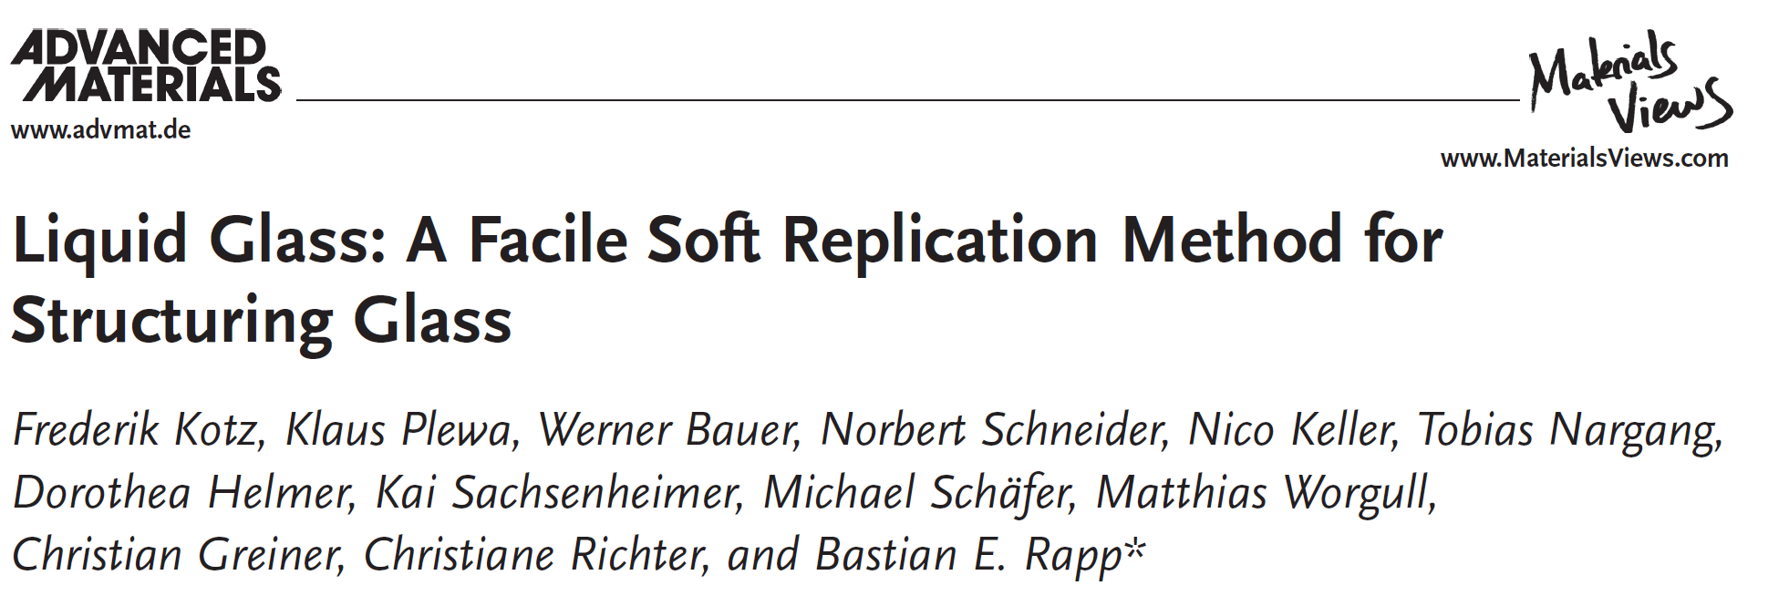
The basis for this work is a nanocomposite that they developed for bulk polymerization
05. 11. 2025

Slide 5
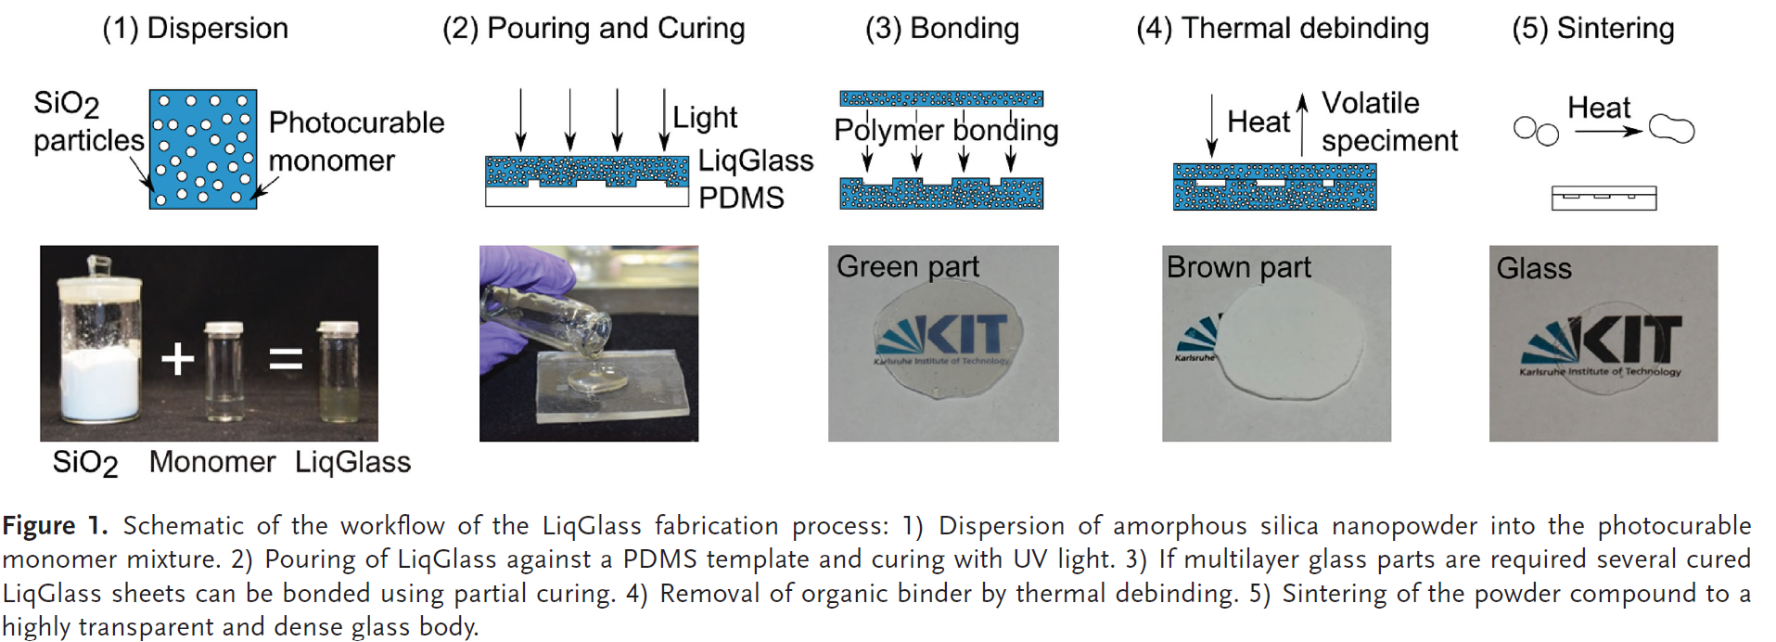
The fabrication process of nanocomposite
The monomer consisted of hydroxyethylmethacrylate (HEMA) and the solvent phenoxyethanol (POE)
A solid loading of 40 vol% was found to be best for obtaining high quality glasses
Index matching of HEMA and the silica nanoparticles results in a translucent slurry allowing photocuring even of thick layers.
05. 11. 2025
Kotz, Frederik, et al. "Liquid glass: a facile soft replication method for structuring glass." Advanced Materials (Deerfield Beach, Fla.) 28.23 (2016): 4646-4650.
Notes:
Monomer which allow the formation of solvation layers around the particles leading to a stable sol and high solid loading without prior particle modification or the use of dispersants.
2-Hydroxyethyl methacrylate (HEMA) has a methacrylate double bond (C=C).
Index match process allows light to pass through, enabling deep photocuring of thick layers (otherwise Incoming light is repeatedly scattered.)
Phenoxyethanol only helps with Nanoparticle dispersion Lowering viscosity Assisting index matching (if its refractive index is close
During debinding the solvent evaporates first leaving a porous monolithic structure
Why is brown: 1. Some carbon fragments (char) are left behind. 2. Partial oxidation 3. The structure is still porous.

Slide 6
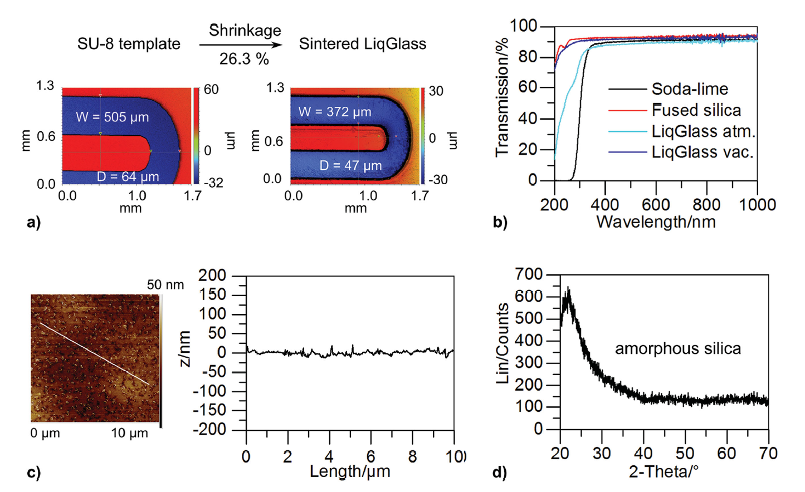
Characterization of LiqGlass
The highest density was found at around 1300 °C.
A solid loading of 40 vol% led to a shrinkage of 26.33% which is in good agreement with the theoretical shrinkage of 26.31%
The decreasing transparency below 300 nm is due to entrapped air.
low surface roughness of R q = 5.92 nm
XRD measurement of sintered LiqGlass parts shows that no devitrification occurs during the sintering process
05. 11. 2025
Kotz, Frederik, et al. "Liquid glass: a facile soft replication method for structuring glass." Advanced Materials (Deerfield Beach, Fla.) 28.23 (2016): 4646-4650.
Notes:
Characterization of LiqGlass:
a) White light interferometry shows the isotropic shrinkage of the parts during the sintering process and the high replication fidelity.
b) UV–vis transmission spectra of sintered LiqGlass under atmospheric conditions and under vacuum compared to commercial
fused silica and soda lime glasses.
c) AFM measurement showing the low surface roughness of R q = 5.92 nm.
d) XRD measurement of sintered LiqGlass parts shows that no devitrification occurs during the sintering process.
(Devitrification means the formation of crystalline phases inside glass during heating) The plot shows a broad peak centered around 2θ ≈ 22–25° and no sharp peaks.

Slide 7
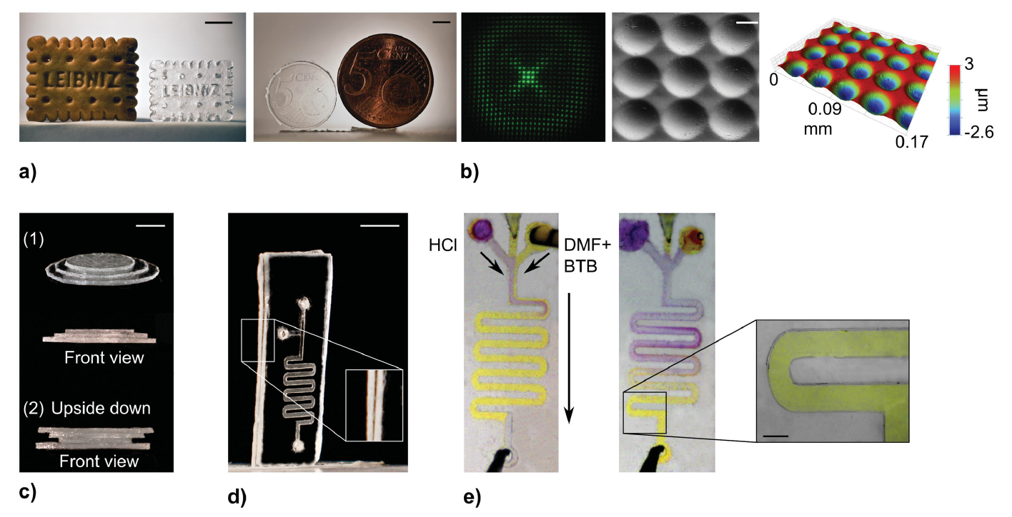
Example objects replicated in LiqGlass
05. 11. 2025
Kotz, Frederik, et al. "Liquid glass: a facile soft replication method for structuring glass." Advanced Materials (Deerfield Beach, Fla.) 28.23 (2016): 4646-4650.
Notes:
Exemple objects replicated in LiqGlass:
a) A cookie (scale bar: 7 mm) and a coin (scale bar: 4 mm) were successfully replicated and turned
into glass.
b) Optical projection pattern obtained from a replicated micro-optical lens array in sintered LiqGlass together with scanning electron microscopy
(SEM) image (scale bar: 15 μm) and profi le of the lenses with a period of 35 μm. As can be seen from the SEM image the structure shows no
visible cracks.
c) Fabrication of multilayer glass systems laminated in the green part state (scale bar: 5 mm): 1) The “Tower of Hanoi” built with three
layers and 2) upside down built with four layers.
d) A microfl uidic glass chip made from two layers (scale bar: 4 mm). The detail view shows the edge of
the chip and the bonding.
e) Capillary fi lling and mixing of bromothymol blue (BTB) dissolved in dimethylformamide (DMF) (yellow) and hydrochloric
acid (HCl) demonstrates the outstanding chemical resistance of sintered LiqGlass parts. The pH-change leads the color change from yellow to purple.
The channels are replicated with high fi delity, perpendicular walls and are bonded successfully (scale bar: 350 μm).

Slide 8
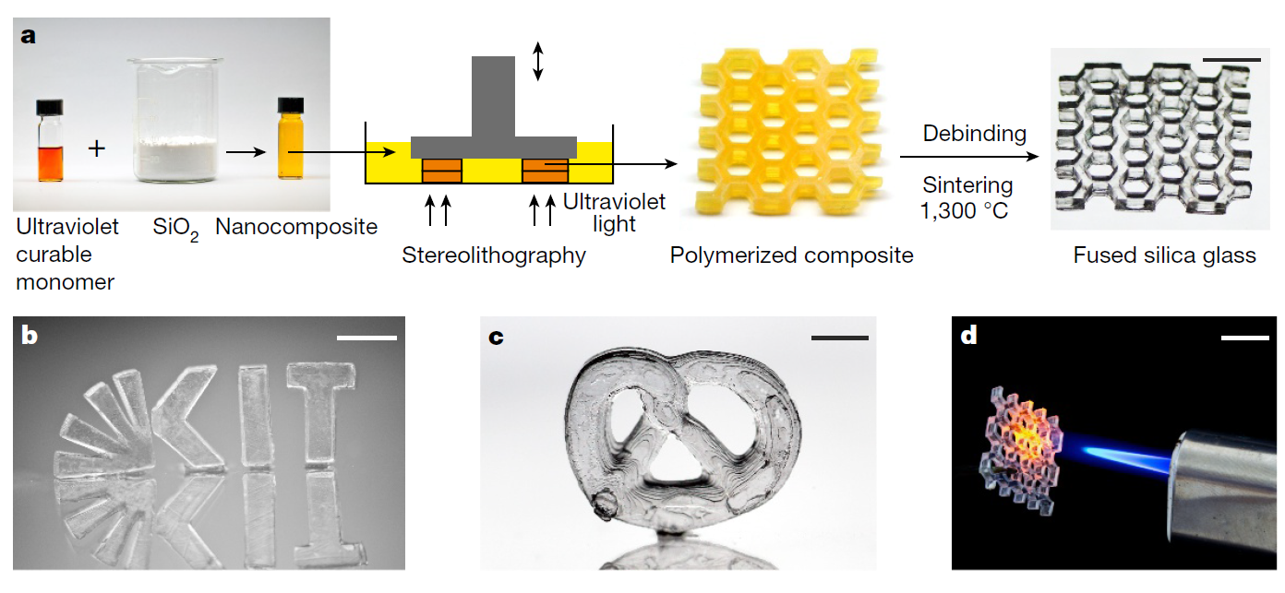
3D printing of fused silica glass
05. 11. 2025
Kotz, Frederik, et al. "Three-dimensional printing of transparent fused silica glass." Nature 544.7650 (2017): 337-339.

Slide 9
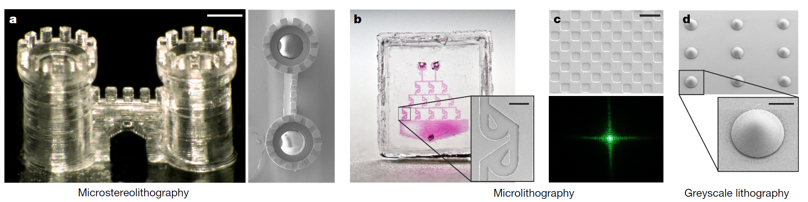
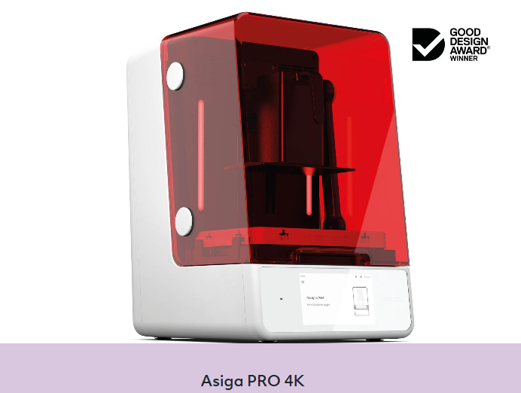
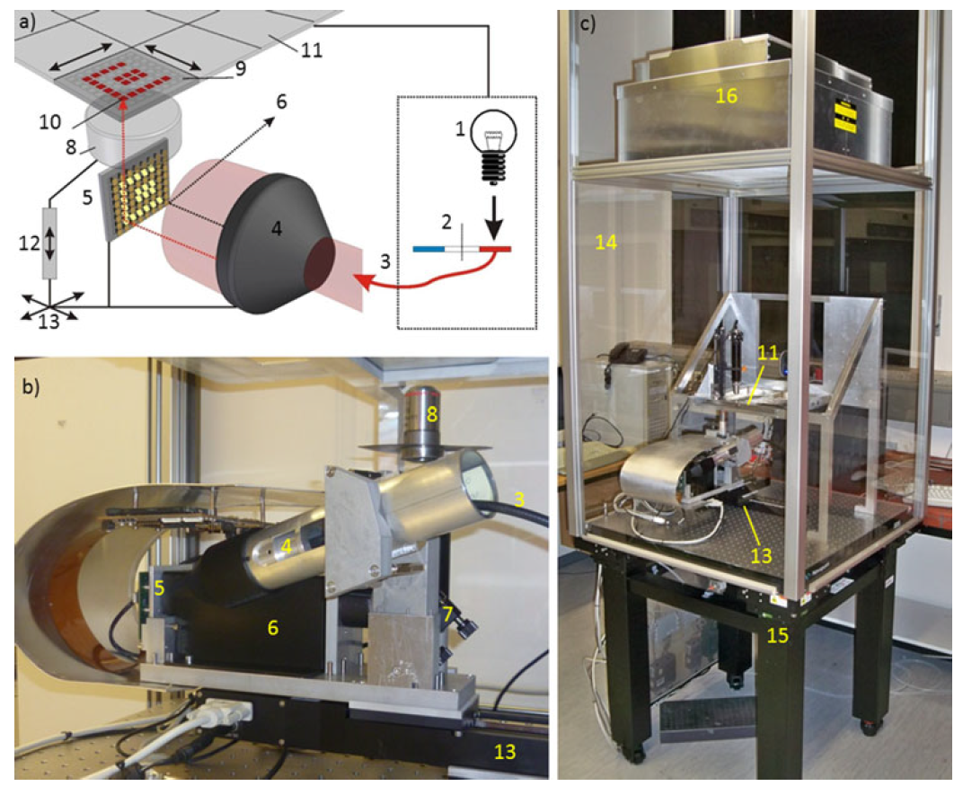
Microstructuring of fused silica glass
stereolithography printers (Asiga Pico 2)
A custom-built micro(stere) lithography system based on a digital mirror device was used to shape fused silica glass at a resolution of a few tens of micrometres.
05. 11. 2025
Microfluidics and Nanofluidics 15.5 (2013): 625-635.
Notes:
Figure 3 | Microstructuring of fused silica glass.
a, Microstereolithography of a hollow castle gate (scale bar, 270 μm).
b, Microlithography of an exemplary microfluidic chip (inset scale bar, 200 μm).
c, Micro-optical diffractive structure creating the optical projection pattern shown at
the bottom (illuminated with a green laser pointer; scale bar, 100 μm).
d, Microlenses fabricated using greyscale lithography (inset scale bar, 100 μm).

Slide 10
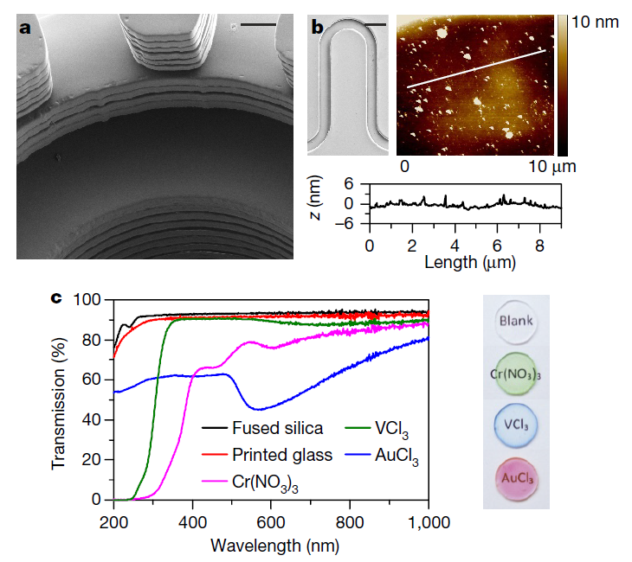

Surface and optical characterization of sintered glass
05. 11. 2025
Notes:
Doping of sintered glass with metal salts leads to coloured binary fused silica glasses (shown on the right).

Slide 11
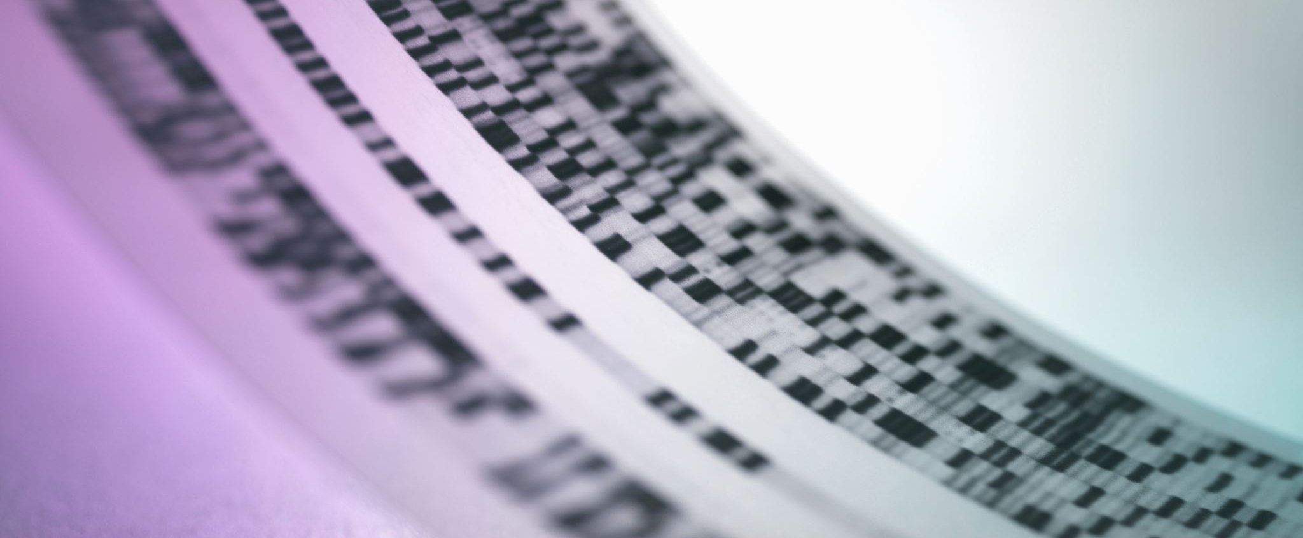
Thanks!
MICRO-722
3D Printing with light
11

